Slide 1
GEOMETRIC MEAN AND HARMONIC MEAN

Slide 2
GEOMETRIC MEAN
In many business and economics problems, we deal with quantities (variables) that change over a period of time.
In such cases the aim is to know an average percentage change rather than simple average value so that we could identify and represent the average growth or decline rate in the variable value over a period of time.
Thus we need to calculate another measure of central tendency called geometric mean (G.M.).

Slide 3
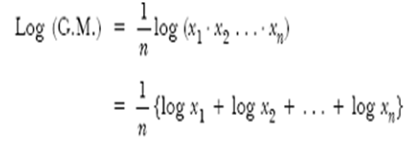

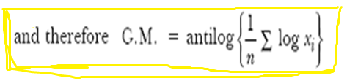
Calculation of G.M.
When the number of observations are more than three, the G.M. can be calculated by taking logarithm on both sides of the equation. The formula for G.M. for ungrouped data can be expressed in terms of logarithm as shown below:

Slide 4
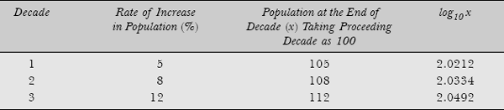
Example: The rate of increase in population of a country during the last three decades is 5 per cent, 8 per cent, and 12 per cent. Find the average rate of growth during the last three decades.
Solution: Since the data is given in terms of percentage, therefore geometric mean is a more appropriate measure. The calculations of geometric mean are shown in

Slide 5




Calculations of G.M.
Hence the average rate of increase in population over the last three decades is 108.2 – 100 = 8.2 per cent.

Slide 6
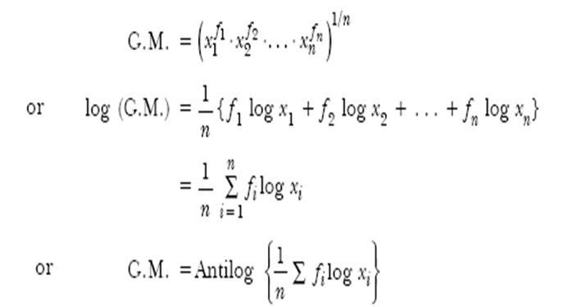
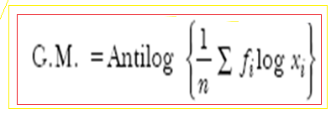
If the observations x₁ x₂,…, x_{n} occur with frequencies f₁, f₂,…, f_{n}, respectively, and the total of frequencies is n = Σ f_{i}, then the G.M. for such data is given by

Slide 7
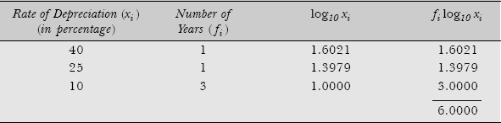
Example : A given machine is assumed to depreciate 40 per cent in value in the first year, 25 per cent in the second year, and 10 per cent per year for the next three years, each percentage being calculated on the diminishing value. What is the average depreciation recorded on the diminishing value for the period of five years?
Solution: The calculations of geometric mean is shown

Slide 8
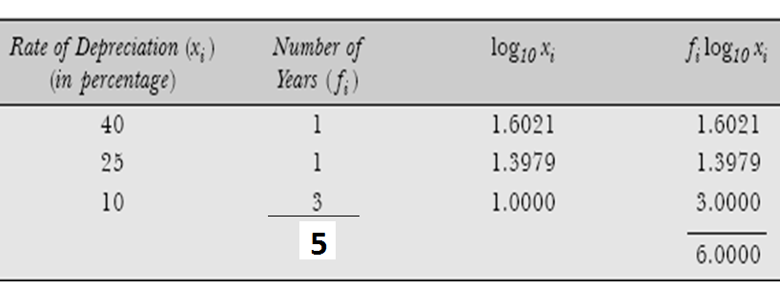



Hence, the average rate of depreciation for first five years is 15.85 per cent.

Slide 9
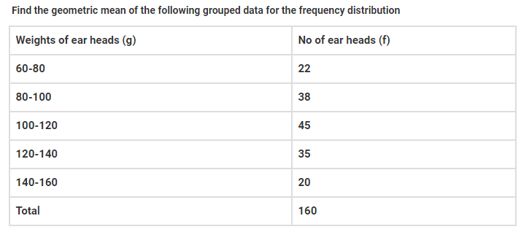

Slide 10
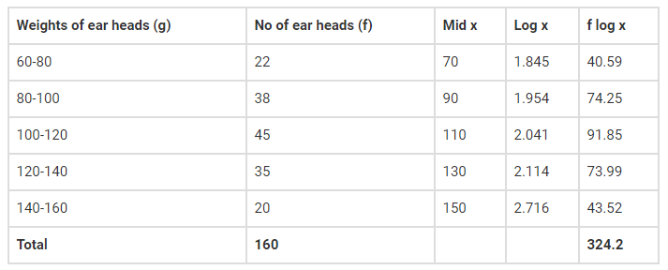


Solution
From the given data, n = 160
We know that the G.M for the grouped data is

Slide 11
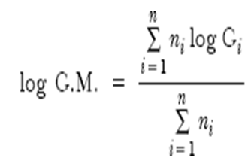
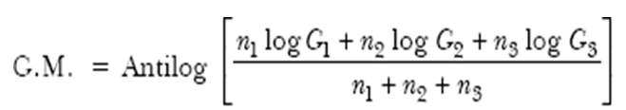
Combined Geometric Mean
The combined geometric mean of observations formed by pooling the geometric means of different sets of data is defined as:
where G_{i} is the geometric mean of the ith data set having n_{i} number of observations.

Slide 12
Example : Three sets of data contain 8, 7, and 5 observations and their geometric means are 8.52, 10.12, and 7.75, respectively. Find the combined geometric mean of 20 observations.
Solution: Applying the formula the combined geometric mean can be obtained as follows:

Slide 13
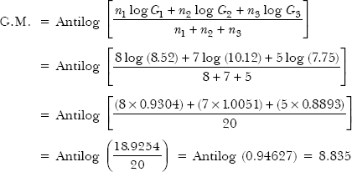
Hence, the combined G.M. of 20 observations is 8.835

Slide 14
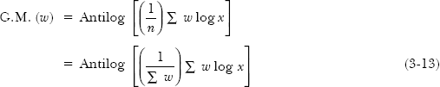
Weighted Geometric Mean
If different observations x_{i} (i = 1, 2,…, n) are given different weights (importance), say w_{i} (i = 1, 2,…, n) respectively, then their weighted geometric mean is defined as:

Slide 15
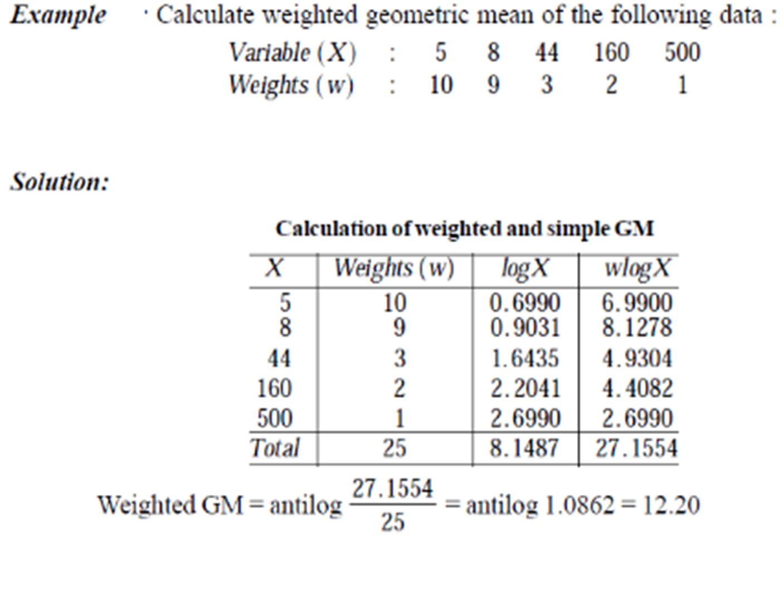

Slide 16
Advantages
The value of G.M. is not much affected by extreme observations and is computed by taking all the observations into account.
It is useful for averaging ratio and percentage as well as in determining rate of increase and decrease.
In the calculation of G.M. more weight is given to smaller values and less weight to higher values. For example, it is useful in the study of price fluctuations where the lower limit can touch zero whereas the upper limit may go upto any number.
It is suitable for algebraic manipulations. The calculation of weighted G.M. and combined G.M. are two examples of algebraic manipulations of the original formula of geometric mean.

Slide 17
Disadvantages
The calculation of G.M. as compared to A.M., is more difficult and intricate.
The value of G.M. cannot be calculated when any of the observation in the data set is either negative or zero.
While calculating weighted geometric, mean equal importance (or weight) is not given to each observation in the data set.

Slide 18
Applications
The concept of G.M. is used in the construction of index numbers.
Since G.M. ≤ A.M., therefore G.M. is useful in those cases where smaller observations are to be given importance. Such cases usually occur in social and economic areas of study.
The G.M. of a data set is useful in estimating the average rate of growth in the initial value of an observation per unit per period. For example, it is useful in finding the percentage increase in sales, profit, production, population, and so on. It is also useful in calculating the amount of money accumulated at the end of n periods, with an original principal amount of P₀.

Slide 19
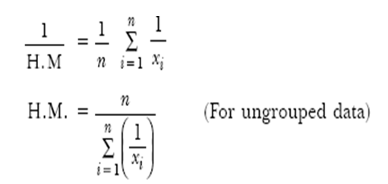
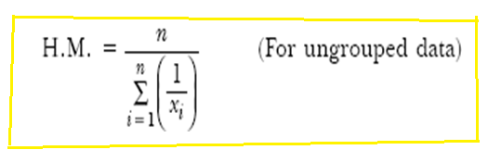
HARMONIC MEAN
The harmonic mean (H.M.) of a set of observations is defined as the reciprocal of the arithmetic mean of the reciprocal of the individual observations, that is,

Slide 20
Example : An investor buys Rs 20,000 worth of shares of a company each month. During the first 3 months he bought the shares at a price of Rs 120, Rs 160, and Rs 210. After 3 months what is the average price paid by him for the shares?
Solution: Since the value of shares is changing after every one month, therefore the required average price per share is the harmonic mean of the prices paid in first three months.
Harmonic mean: A value that is the reciprocal of the mean of the reciprocals of a set of numbers.

Slide 21


Slide 22
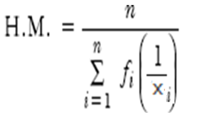
If f₁, f₂,…, f_{n} are the frequencies of observations x₁, x₂,…, x_{n}, then the harmonic mean is defined as:

Slide 23
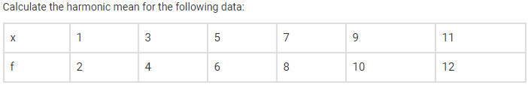
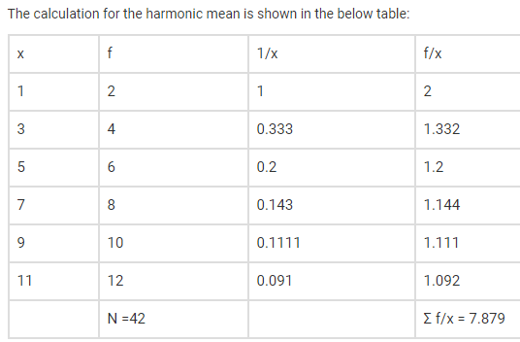

Slide 24
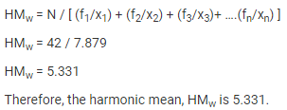

Slide 25
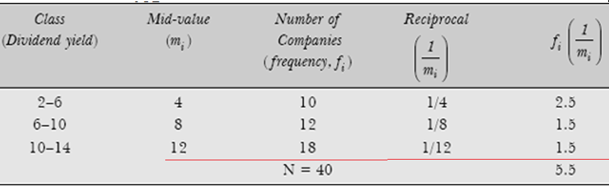

Example : Find the harmonic mean of the following distribution of data
Hence the average dividend yield of 40 companies is 7.27 per cent.

Slide 26
Advantages
The H.M. of the given data set is also computed based on its every element.
While calculating H.M., more weightage is given to smaller values in a data set because in this case the reciprocal of given values is taken for the calculation of H.M.
The original formula of H.M. can be extended to accommodate further analysis of data by certain algebraic manipulations.
Disadvantages
The H.M. is not often used for analysing business problems.
The H.M. of any data set cannot be calculated if it has negative and/or zero elements.
The calculation of H.M. involves complicated calculations. For calculating the H.M. of a data set, the largest weight is given to smaller values of elements, therefore it does not represent the true characteristic of the data set.

Slide 27
Applications The harmonic mean is particularly useful for computation of average rates and ratios. Such rates and ratios are generally used to express relations between two different types of measuring units that can be expressed reciprocally. For example, distance (in km), and time (in hours).

